Slide 1
Embedded System Software Embedded기반 Webcam controller
컴퓨터공학과
120230200
김지섭
Sogang University, Seoul
South Korea

Slide 2
Contents
Introduction
Service architecture
Implementation
Demonstration

Slide 3
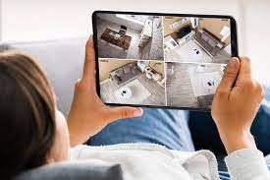
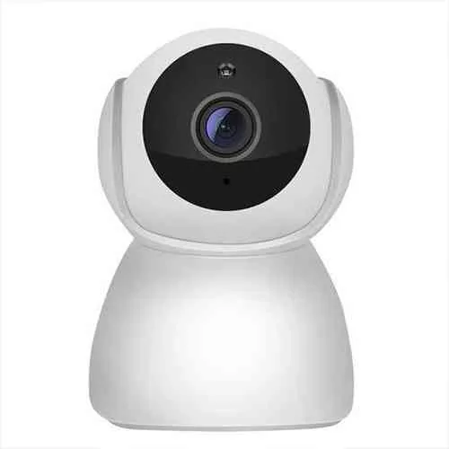
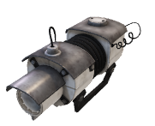
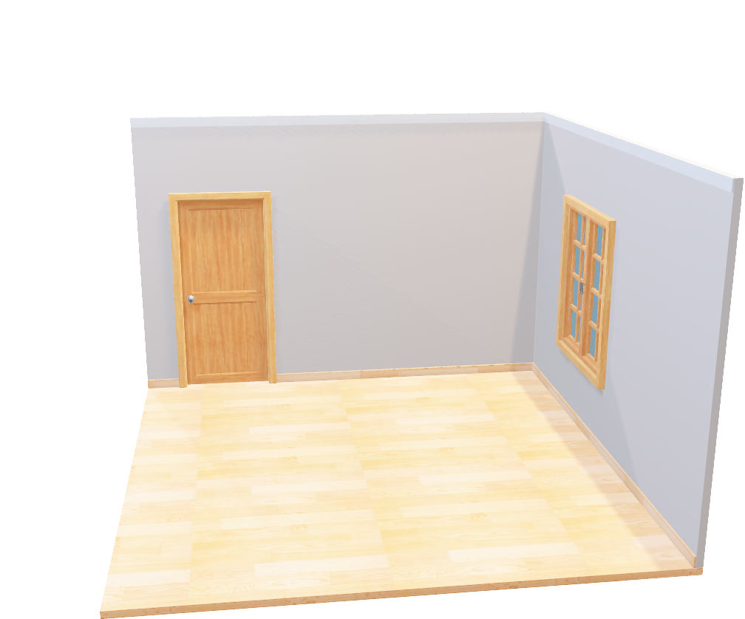
Introduction

Slide 4



Service architecture
Android UI
Hardware Design
Image View
Webcam

Slide 5
Service architecture
Android UI
Hardware Design
Image View
Webcam

Slide 6
Service architecture
Android Layer
WebCamImage
MainActivity
Kernel Layer
JNI Layer
FPGA device driver
Motor_jni
Button
Motor
Video for Linux2
Motor
WebCam
Hardware Layer

Slide 7
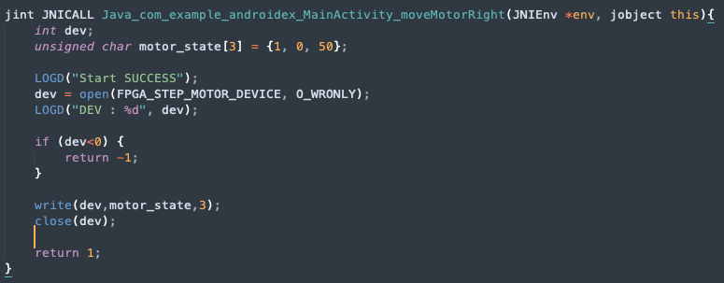
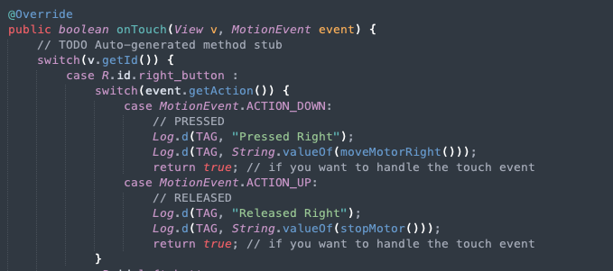
Implementation
Motor 구동

Slide 8
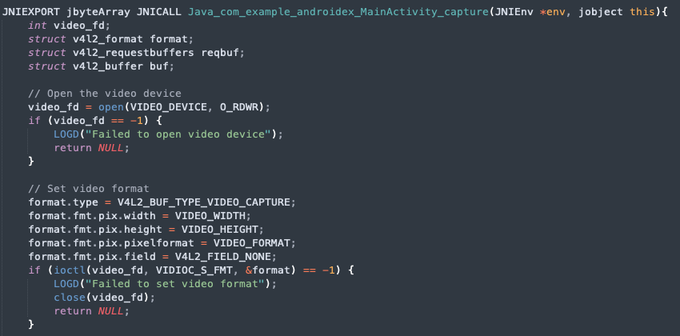
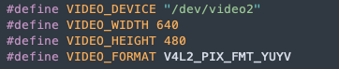
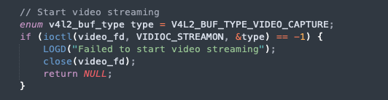
Implementation
Webcam 이미지 촬영

Slide 9
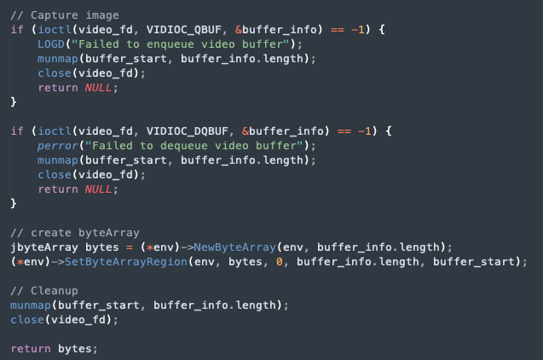
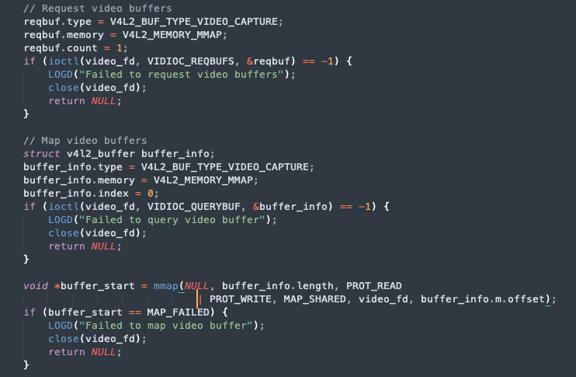
Implementation
Webcam 이미지 촬영

Slide 10
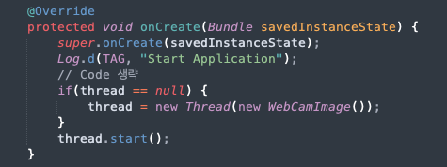
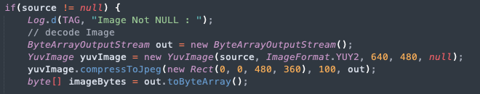
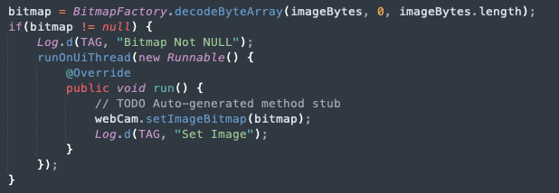
Implementation
ImageView update

Slide 11
Demonstration
시 연

